Slide 1
Sales Analysis Using SQL

Slide 2
Steps taken
1. Created sales database
2. Importing data/tables
3. Review the schema diagram
4. Review the problem statement

Slide 3
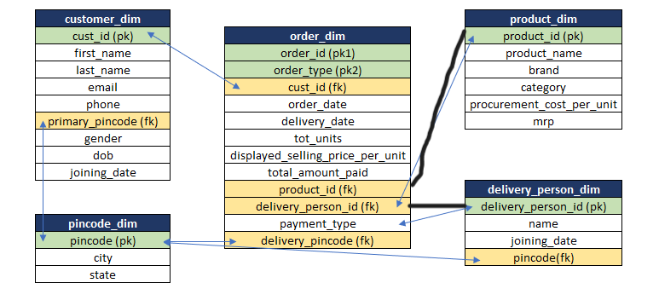
Schema Diagram

Slide 4
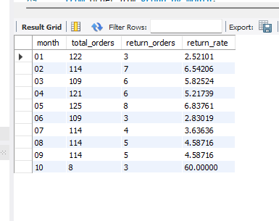
Problem statement
1. How many total orders were there in each month and how many of them were returned?

Slide 5
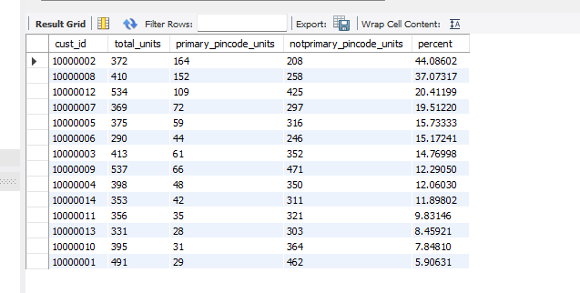
2.For every customer, print how many total units were ordered, how many units were ordered from their primary_pincode and how many were ordered not from the primary_pincode. Also calulate the percentage of total units which were ordered from primary_pincode.

Slide 6
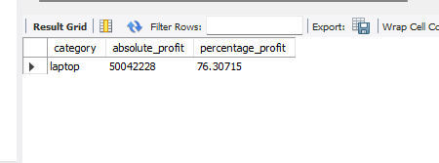
3.Find which product category has made the most profit in both absolute amount and percentage Absolute profit.

Slide 7
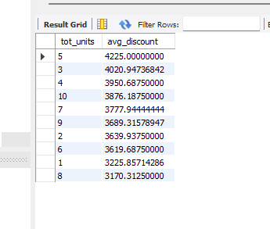
4.Generally the more numbers of units you buy, the more discount seller will give you. For 'Dell AX420' is there a relationship between number of units ordered and average discount from selling price?

